Slide 1
CREDIT CARD PAYMENT DEFAULTERS
DAB 103 Analytical Tools & Decision Making
Section: 004
Group: 01

Slide 2





MEET OUR TEAM
Ambily Treesa Varghese
Dileep Sathyan
Jibina Francis
Satya Akhil Govvala
Srilakshmi Gummadidala

Slide 3
BACKGROUND / MOTIVATION
A Bank gets 100s of new Credit Card applications every single day from their users.
Although the bank might give their users a Credit Card with a minimum line to increase their customer acquisition, it is one of the biggest challenges any financial institution faces when it comes to payment collection.
Around 22% of the credit card users of the financial institution are found to default on their repayment, resulting in huge losses.
Identifying the potential defaulters within the first 6 months of their repayment will mitigate the risks with credit lending.

Slide 4
Problem statement
Financial institutions require a better understanding of their credit users and their consumption patterns. This will help mitigate their credit lending risks by identifying the potential defaulters as well as enable them to cater better services to their loyal customers.

Slide 5
Project proposal
Our project team will create a descriptive analytics product to identify the characteristics of payment defaulters and thus helping the financial institution take necessary measures to control the credit consumption of such users.

Slide 6
Analysis questions
What are the age demographics of the major customers of the financial institution and which age groups are having a higher tendency to default?
How is the credit limit distributed among defaulters and non-defaulters?
Is the Bill Statement Amount distributed normally among the users? If not, what kind of skewness can be observed?
How are the bill amounts generated for the users varying each month?
Which variables in the dataset have a stronger correlation with the users going default?

Slide 7

DATASET DESCRIPTION
The dataset contains the credit card usage and repayment history of 6 months (April to September 2005) of a Financial Institution in Taiwan.
Our analysis will be based on the repayment Default of Credit Card Clients Data Set obtained from the UCI Machine Learning Repository.
The description of certain values in some fields in the dataset is unavailable, although the dataset doesn’t have incomplete or missing data.
Dataset Source

Slide 8
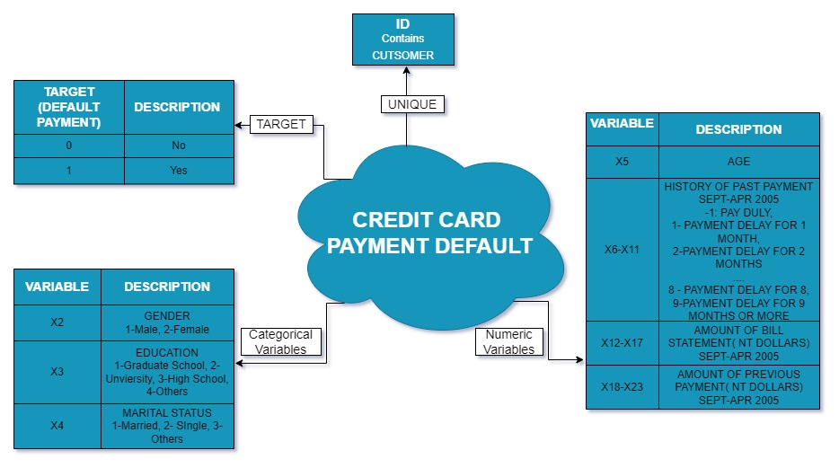
DATASET ATTRIBUTE DESCRIPTION

Slide 9
EXPLORATORY DATA ANALYSIS

Slide 10
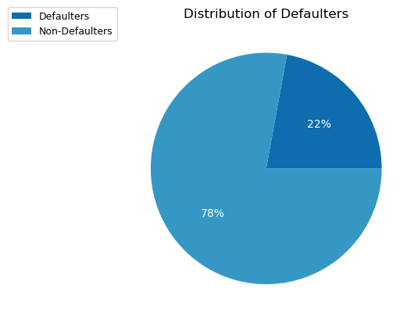
DEFAULTER DISTRIBUTION
The dataset contains 22% of records labeled as DEFAULTERS while the rest as Happy-Paying-Customers.
The Financial Institution requires measures to identify the defaulters as early as possible to control credit risks.

Slide 11
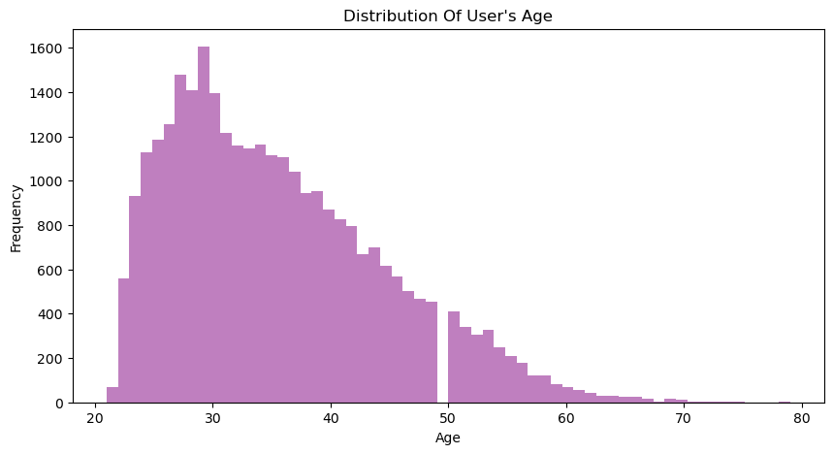
AGE DISTRIBUTION
Most credit card users are in their early twenties to late forties.
The average age of the users is currently 30 years.

Slide 12
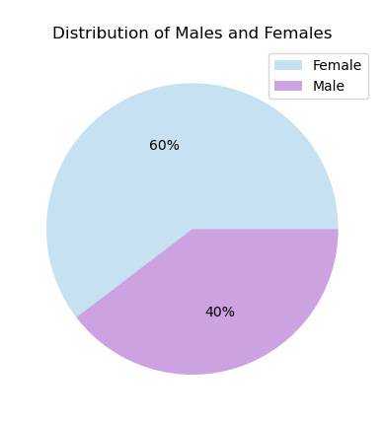
GEnder DISTRIBUTION
The dataset under analysis has a 3:2 Female to Male client ratio.

Slide 13
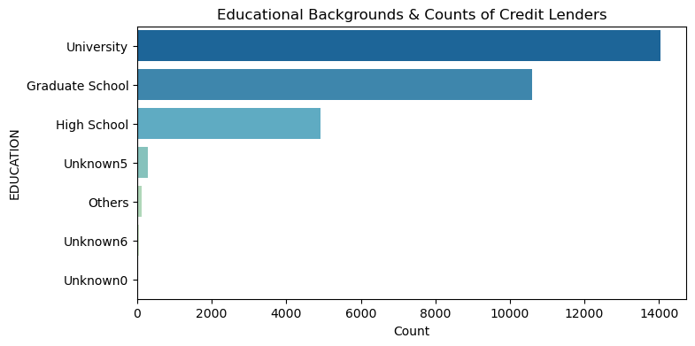
CREDIT LENDERS BY EDUCATIONAL BACKGROUND
The institution seemingly considers the Educational Background as one of the major parameters for issuing a credit card.
The count of credit card users is directly proportional to the Educational qualification they have.

Slide 14
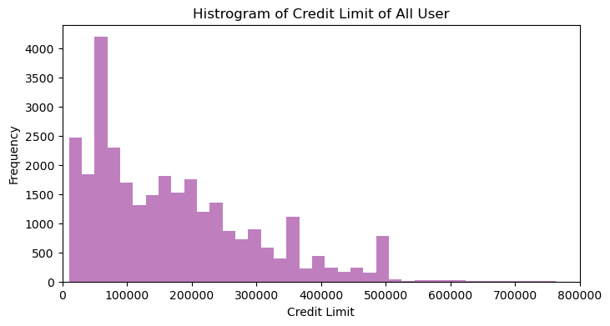
USER CREDIT LIMIT
Credit limits issued by the Institution to its users are Normally distributed with a right skew.
Majority of the users are given a credit limit of less than NT$ 250,000 (New Taiwan Dollar)

Slide 15
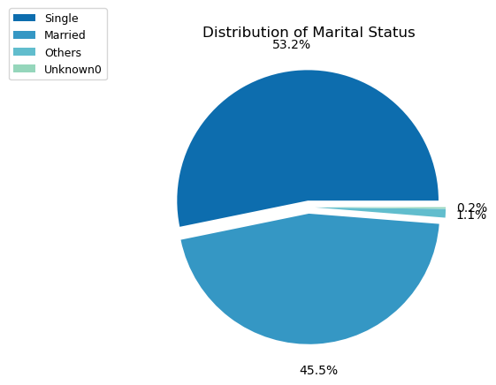
DISTRIBUTION OF MARITAL STATUS
53% of the users in the dataset are Single, followed by 46% Married users.
A very few proportions of users belong to Others and Unspecified groups

Slide 16
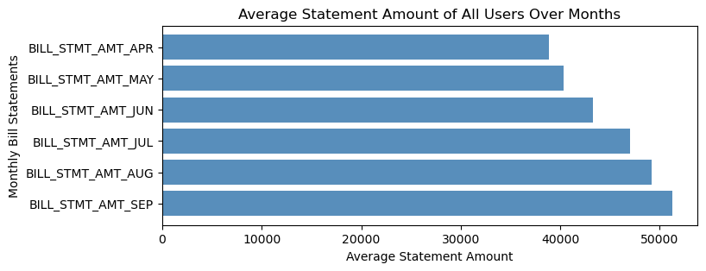
BILL STATEMENT AMOUNTS
On average, the Financial Institution raises Bill Statements which amount to NT$ 40k to 50k to their users in a month.
The statement amount grows over the months either because of the usage or the accumulation of credit due to repayment default.

Slide 17
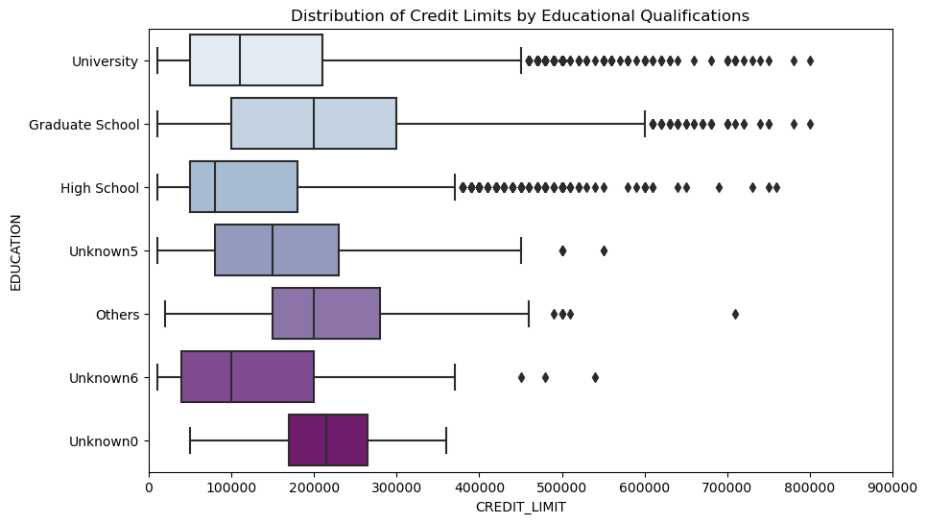
CREDIT LENDER COUNT BY EDUCATIONAL QUALIFICATION
The median credit limit varies with the Educational Qualification of users.
Although there are more University graduates who own a credit card, the users with Graduate School qualifications seem to have a better Median score.
Category-wise outliers are visible in the figure, except for "Unknown0".

Slide 18
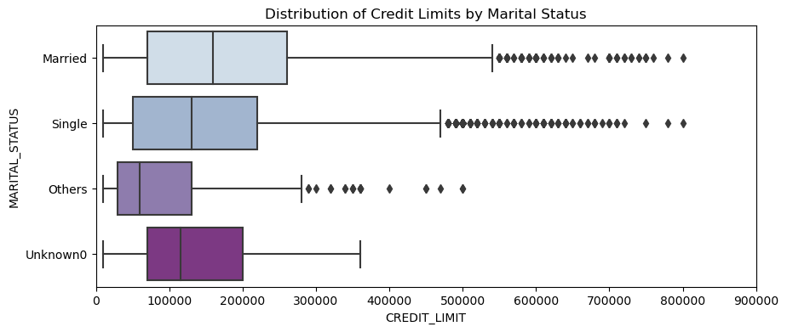
CREDIT LIMIT BY MARITAL STATUS
The plot distribution describes the Credit Limit of each Marital Status category such as Married, Single, Others, and Unknown0.
The highest credit lenders are Married Individuals followed by Single and Unknown0 category users.
Here, Married, Single and Others types of Marital Status categories have outliers as per their Credit Limit.

Slide 19
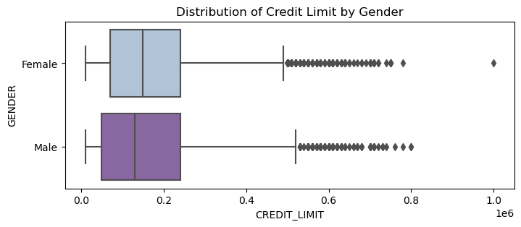
CREDIT LIMIT BY GENDER
Females, the category having more credit cards in our dataset, possess a slightly higher median Credit Limit than Males.
The Outliers are present in both Female and Male categories ranging from NT $500000 to above as per their Credit Limit.

Slide 20
Data Cleaning, Transformation & Analysis

Slide 21
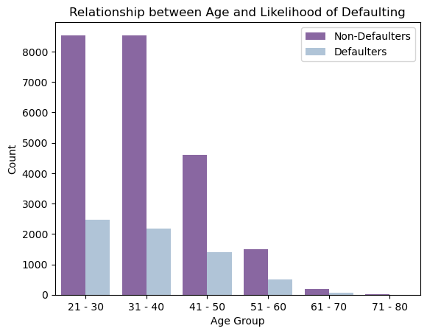
Age Demographics on Defaulting
Millennials and Gen-Z are the major customers and contribute to most of the defaulters.

Slide 22
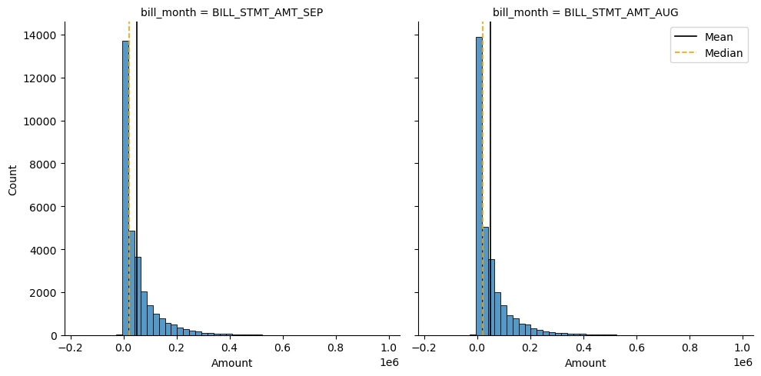
Skewness in Bill Statements
Monthly Bill Statements Amounts exhibit a right skewness which increases the Mean Statement Amount from the Median value.

Slide 23
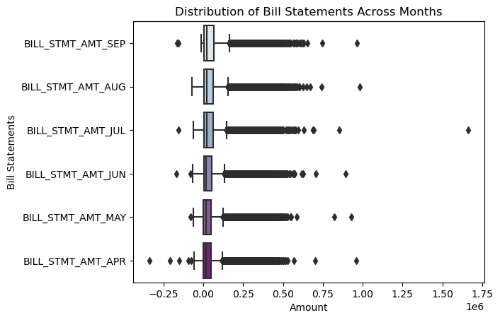
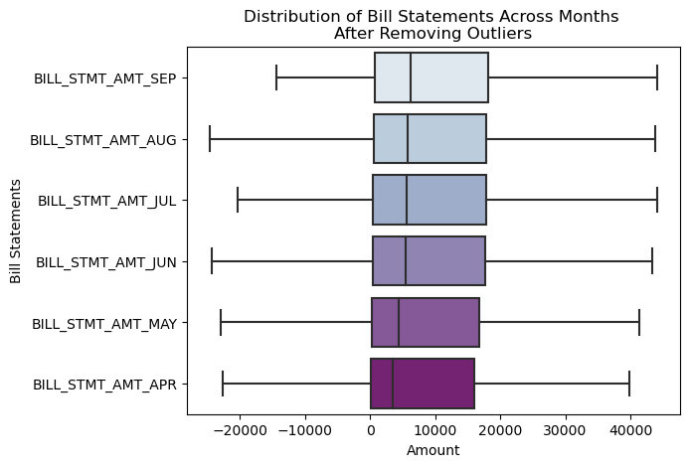
BILL STATEMENT ACROSS MONTHS
Bill statements generated seem to highly vary for the users across each month.
The chart above shows the data after cleaning the outliers.

Slide 24
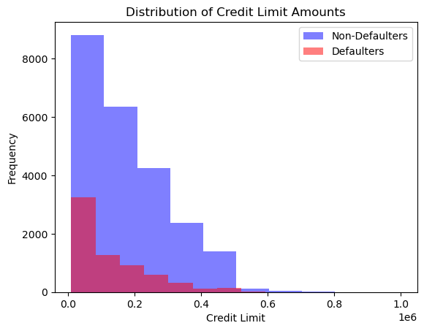
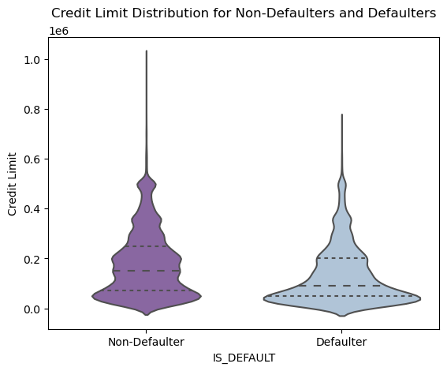
CREDIT LIMIT DISTRIBUTION ACROSS USER TYPES
Median Credit Limit amounts of the Defaulters are slightly lower than that of Non-Defaulters.

Slide 25
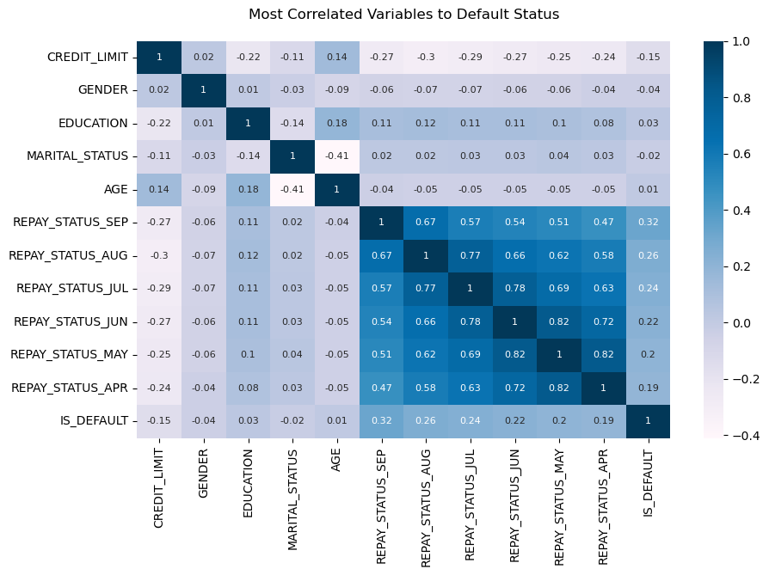
Correlating Features
Among the relevant features, the REPAYMENT_STATUS per month seems to have a higher correlation to the dependent variable.

Slide 26
Conclusion
The customers of the financial institution are mostly Women (~60%).
22% of the users in the dataset are defaulters.
Users aged between 21 to 40 are the major customers of this financial institution and they also tend to rank first in terms of default.
Median Credit Limit amounts of the Defaulters are slightly lower than that of Non-Defaulters.
Bill Statements generated seem to highly vary for the users across each month.
REPAYMENT_STATUS for every month seems to have a higher correlation to the dependent variable

Slide 27
RECOMMENDATIONS
Since customers below the age of 40 seem to have a higher tendency to default the financial institution needs to closely assess their spending and repayment patterns.
The repayment Status for each month is a great indicator of a potential payment default. Hence monitoring the same can help reduce the default rate of the entire client base.

Slide 28
REFERENCES
Development Team, M. (2021). Matplotlib.pyplot.barh — matplotlib 3.1.2 documentation. matplotlib.pyplot.barh. Retrieved April 20, 2023, from https://matplotlib.org/3.1.1/api/_as_gen/matplotlib.pyplot.barh.html
Holtz, Y. (2018). Control color in Seaborn heatmaps. The Python Graph Gallery. Retrieved April 20, 2023, from https://www.python-graph-gallery.com/92-control-color-in-seaborn-heatmaps
Jones, M. (2020, April 19). Color guide to seaborn palettes. Medium. Retrieved April 20, 2023, from https://medium.com/@morganjonesartist/color-guide-to-seaborn-palettes-da849406d44f
McKinney, T. (2021, May 20). How to add a mean and median line to a seaborn displot. Stack Overflow. Retrieved April 20, 2023, from https://stackoverflow.com/questions/67613774/how-to-add-a-mean-and-median-line-to-a-seaborn-displot
Wascom, M. (2020). Seaborn.FacetGrid. seaborn.FacetGrid - seaborn 0.12.2 documentation. Retrieved April 20, 2023, from https://seaborn.pydata.org/generated/seaborn.FacetGrid.html
Waskom, M. (2020). Building structured multi-plot grids. Building structured multi-plot grids - seaborn 0.12.2 documentation. Retrieved April 20, 2023, from https://seaborn.pydata.org/tutorial/axis_grids.html
Waskom, M. (2020). Seaborn.displot. seaborn.displot - seaborn 0.12.2 documentation. Retrieved April 20, 2023, from https://seaborn.pydata.org/generated/seaborn.displot.html
Waskom, M. (2021). Seaborn.color_palette. seaborn.color_palette - seaborn 0.12.2 documentation. Retrieved April 20, 2023, from https://seaborn.pydata.org/generated/seaborn.color_palette.html
Yeh, I.-C. (2016, January 26). Default of credit card clients data set. UCI Machine Learning Repository: Default of credit card clients data set. Retrieved April 20, 2023, from https://archive.ics.uci.edu/ml/datasets/default+of+credit+card+clients

Slide 29
THANK YOU

